Slide 1
Reading Text Files
Mack 2022
Notes:
Last updated: 10-31-2022

Slide 2
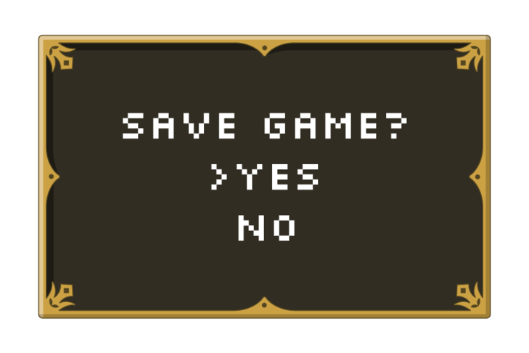
Discuss
Starter activity
How limited would gaming be if you could never save your progress?
Discuss with a partner before feeding back to the class.
Notes:
Image taken from a Raspberry Pi Foundation course on FutureLearn

Slide 3

Lesson 33: Reading text files
Objectives
In this lesson, you will:
Determine the purpose of external data files
Read data from an external text file

Slide 4
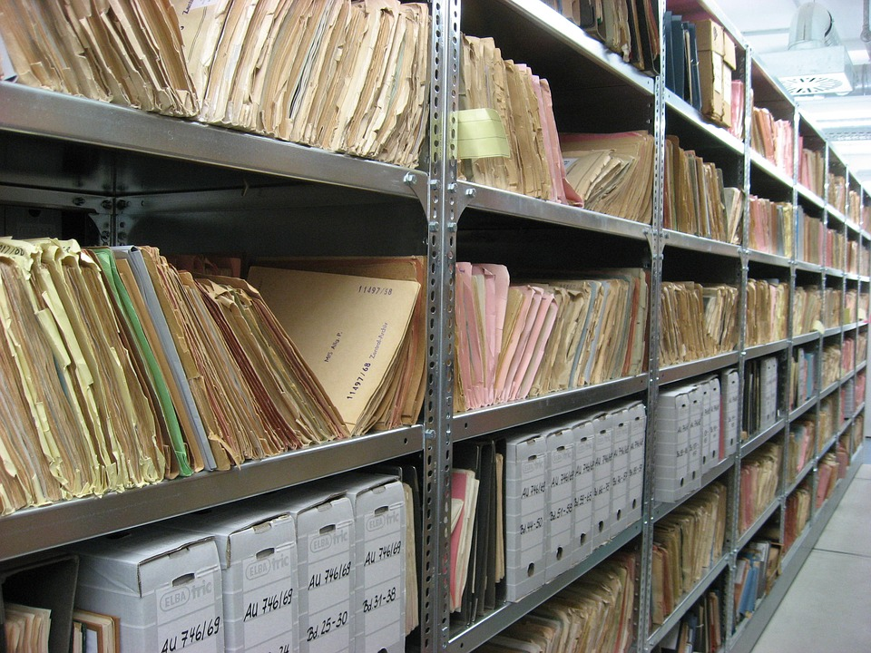
Files
Activity 1
A file is a term used to describe data that is held in storage on a computer.
Files come in many forms, for example:
Text files
Image files
Video files
Sound files
Notes:
Image source: https://pixabay.com/photos/files-ddr-archive-1633406/

Slide 5
Files
Activity 1
Files can often be used by other programs for different purposes.
For example, if you create an image in a painting package, you can then use that same image in a presentation that you have made.
Notes:
Image source: https://pixabay.com/photos/files-ddr-archive-1633406/

Slide 6
File handling
Activity 1
File handling is a term used to describe how programs work with the files that are stored in a computer.
Having the ability to use file-handling techniques in your own programs opens up endless possibilities.
Notes:
Image source: https://pixabay.com/photos/files-ddr-archive-1633406/

Slide 7
File handling
Activity 1
All of the programs that you have created so far have lost any data generated within them once they have been terminated.
Saving program data to an external file allows you to use that data again.
Notes:
Image source: https://pixabay.com/photos/files-ddr-archive-1633406/

Slide 8

File handling
Activity 1
An example of when this might be used is to keep track of the highest score for a game.
A text file can be used to store the highest score and this can be accessed and modified each time the game is played.
Notes:
Image taken from a Raspberry Pi Foundation course on FutureLearn

Slide 9
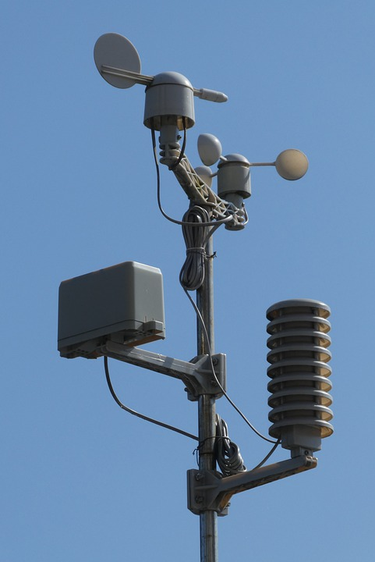
File handling
Activity 1
Another example is when a program can be designed to access large data sets.
A weather station can use sensors to take weather readings that are stored in a data file.
A program can then analyse the data in the file to make predictions about the weather.
Notes:
Image source: https://pixabay.com/photos/weather-station-weather-vane-set-5010904/

Slide 10
File handling
Activity 1
Question .
Can you think of any other examples of when file-handling techniques might be used?
Game progress
Test scores
Player names
Restaurant orders
Stock levels

Slide 11
File handling in Python
Activity 2
The key file-handling techniques that you need to be able to use are:
Open
Read
Close
Write
Append

Slide 12
File handling in Python
Activity 2
This lesson will focus on the first three:
Open
Read
Close

Slide 13

Open and read a text file
Activity 2
In order to read the data stored in a text file, you must open it first.
Think of it a bit like a book. You can’t read what is inside if you don’t open it first.

Slide 14
Open a text file
Activity 2
file = open("quick.txt","r")
Here is an instruction that will open a text file in read mode.

Slide 15
Open a text file
Activity 2
file = open("quick.txt","r")
Here is an instruction that will open a text file in read mode.
Creates an identifier for the file that is to be accessed.

Slide 16
Open a text file
Activity 2
file = open("quick.txt","r")
Here is an instruction that will open a text file in read mode.
Calls a function that returns a file object.

Slide 17
Open a text file
Activity 2
file = open("quick.txt","r")
Here is an instruction that will open a text file in read mode.
The first argument is the name of the text file to be opened.

Slide 18
Open a text file
Activity 2
file = open("quick.txt","r")
Here is an instruction that will open a text file in read mode.
The second argument is the mode that the file will be opened.

Slide 19

Open a text file: modes
Activity 2
file = open("quick.txt","r")
There are four modes for opening a file:
r for only reading files
w for only writing to files
a for adding to an existing file
r+ for reading and writing files
Opening a file in write mode will erase any existing file with the same name.

Slide 20
Read a text file
Activity 2
file = open("quick.txt","r")
quicktext = file.read()
Once a file has been opened, it can then be read.

Slide 21
Read a text file
Activity 2
file = open("quick.txt","r")
quicktext = file.read()
Once a file has been opened, it can then be read.
Creates a variable that will hold the contents of the text file.

Slide 22
Read a text file
Activity 2
file = open("quick.txt","r")
quicktext = file.read()
Once a file has been opened, it can then be read.
Is the identifier for the text file that has been opened.

Slide 23
Read a text file
Activity 2
file = open("quick.txt","r")
quicktext = file.read()
Once a file has been opened, it can then be read.
Is a method that is used to read the contents of the text file.

Slide 24
Read a text file
Activity 2
file = open("quick.txt","r")
quicktext = file.read()
The text file must be saved in the same location as your Python file for the program to work.
You must not use the same variable name as the file identifier in your program.

Slide 25
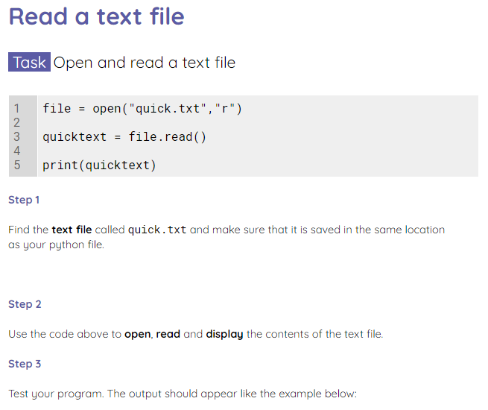
Read a text file
Activity 2
Use the worksheet to practise opening and reading a text file.

Slide 26
Reading lines from a text file
Activity 3
1 2 3 | file = open("quick.txt","r") print(file.readline())
The readline() method can be used to read a single line from a text file.
The method will return the line with \n at the end of the string. This adds a new line.
 | A >>>

Slide 27
Reading lines from a text file
Activity 3
1 2 3 4 | file = open("quick.txt","r") print(file.readline()) print(file.readline())
Each time the readline() method is called, the next line in the text file will be returned.
 | A quick >>>

Slide 28
Reading lines from a text file
Activity 3
1 2 3 4 | file = open("quick.txt","r") for line in file: print(line)
You can also iterate over a text file using a for loop.
Question .
What do you think the output will be when this program is executed?

Slide 29
Reading lines from a text file
Activity 3
 | A quick brown fox jumps over the lazy dog >>>
Answer .
For every line in the text file, it will print the line, along with a line space.

Slide 30
Reading lines from a text file
Activity 3
1 2 3 4 | file = open("quick.txt","r") for line in file: print(line.strip())
To remove the extra line space, the strip() method can be used.
 | A quick brown fox jumps over the lazy dog >>>

Slide 31
Reading lines from a text file
Activity 3
1 2 3 4 5 | file = open("quick.txt","r") quicklist = file.readlines() print(quicklist)
Another tool for reading lines is the readlines() method.
You can use this to place each line of the text file as an item in a list.
 | ['A\n', 'quick\n', 'brown\n', 'fox\n', 'jumps\n', 'over\n', 'the\n', 'lazy\n', 'dog'] >>>

Slide 32

Reading lines from a text file
Activity 3
1 2 3 4 5 | file = open("quick.txt","r") quicklist = file.readlines() print(quicklist)
The \n becomes more apparent when you see the data in this way.
 | ['A\n', 'quick\n', 'brown\n', 'fox\n', 'jumps\n', 'over\n', 'the\n', 'lazy\n', 'dog'] >>>
Note that \n is not added to the final line in the text file.

Slide 33
Reading lines from a text file
Activity 3
1 2 3 4 5 6 7 8 | file = open("quick.txt","r") quicklist = [] for line in file: quicklist.append(line.strip()) print(quicklist)
If you want to populate a list with lines from a text file but you don’t want \n included in the list, you can write a for loop to populate the list instead.
 | ['A', 'quick', 'brown', 'fox', 'jumps', 'over', 'the', 'lazy', 'dog'] >>>

Slide 34
Default data type
Activity 3
1 2 3 4 5 6 7 8 | file = open("numbers.txt","r") numberlist = [] for line in file: numberlist.append(line.strip()) print(numberlist)
When the data is copied from a text file, it will automatically be held using the string data type.
 | ['1', '2', '3', '4', '5', '6', '7', '8', '9', '10'] >>>
Note the '' around each number in the list.

Slide 35
Default data type
Activity 3
1 2 3 4 5 6 7 8 | file = open("numbers.txt","r") numberlist = [] for line in file: numberlist.append(int(line.strip())) print(numberlist)
To change the data type, you will need to use casting.
This data should be held as an integer so you can cast it as an integer as you populate the list.
 | [1, 2, 3, 4, 5, 6, 7, 8, 9, 10] >>>
Note that there are no longer quotes around each number.

Slide 36
Closing a file
Activity 3
1 2 3 4 5 6 7 | file = open("quick.txt","r") quicktext = file.read() file.close() print(quicktext)
Once you have performed all of the tasks that you need to with a file, it is important to close it.
This will free up system resources and protect the data.

Slide 37
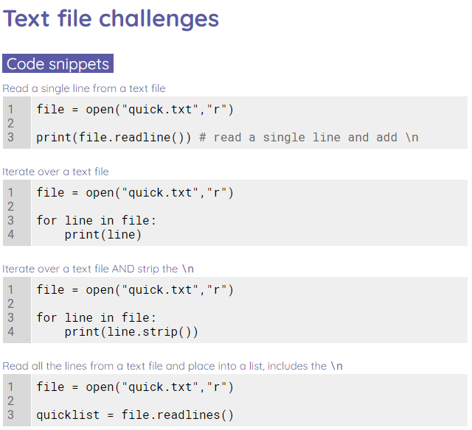
Text file challenges
Activity 3
Use the worksheet to complete some text file challenges.

Slide 38
Match the method to the description
Plenary
readline()
Removes the \n from the end of the string
readlines()
To be used when you are finished accessing the text file
strip()
Reads the entire text file
read()
Reads a single line from the text file
close()
Reads all of the lines and places them into a list

Slide 39
Next lesson
Summary
In this lesson, you…
Learnt how to read a text file and work with the data in the text file
Next lesson, you will…
Learn how to write to a text file

